Slide 1
AIRBNB Bookings Insights (Tableau)
Akshay Khanna

Slide 2





company Overview
Airbnb, Inc. is an American San Francisco-based company operating an online marketplace for short- and long-term homestays and experiences. The company acts as a broker and charges a commission from each booking. The company was founded in 2008 and is a shortened version of its original name, AirBedandBreakfast.com. Airbnb is the most well-known company for short-term housing rentals.
Airbnb generated $8.3 billion in revenue in 2022, a 40% year-on-year increase
Airbnb has 200+ million users as of 2020
In 2022, 393 million bookings were made on Airbnb, a 31% increase on 2021
There were 6.6 million listings on Airbnb, run by four million hosts
Source – Business of Apps & Wikipedia

Slide 3

Data Overview, Variables & Data Issues
Platform Registration
Host Registration Date
Geography
Neighborhood
Zipcode
Customer Ratings
Review Count
Average Rating
Pricing Details
Price for BnB
BnB Type
Room Type (Apartment, Private Room, Shared Room)
Property Type – 18 Subcategories like Villa, Dorm, Loft etc.``
Data Overview
30K+ data points
Critical Variables
Parameters of Interest – Neighborhood, Property Type, Ratings, Hosting Since, Room type and Price
Data Issues
No ratings for 30% records
Data Granularity – Host Level Details
Data Recency – Up till 2015 from inception
Geography – Only New York

Slide 4
Insights from the analysis
Geographical Analysis
Platform registration rate across geographies – Yearly and Monthly
Impact of external events on registration rate
Host Rating Analysis
Dashboard of Top N Hosts across geographies and room categories
Forecasting future platform registration and pricing trends across geographies
Pricing and BNB type preference across geographies
Correlation of ratings with pricing
Most profitable cluster of hosts (High Review Count and High Price)

Slide 5
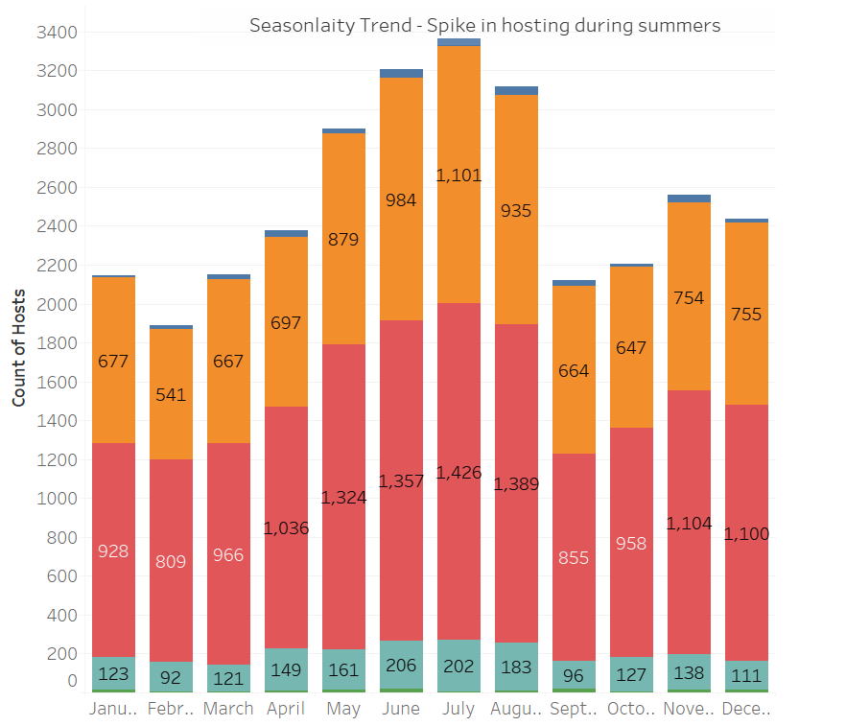
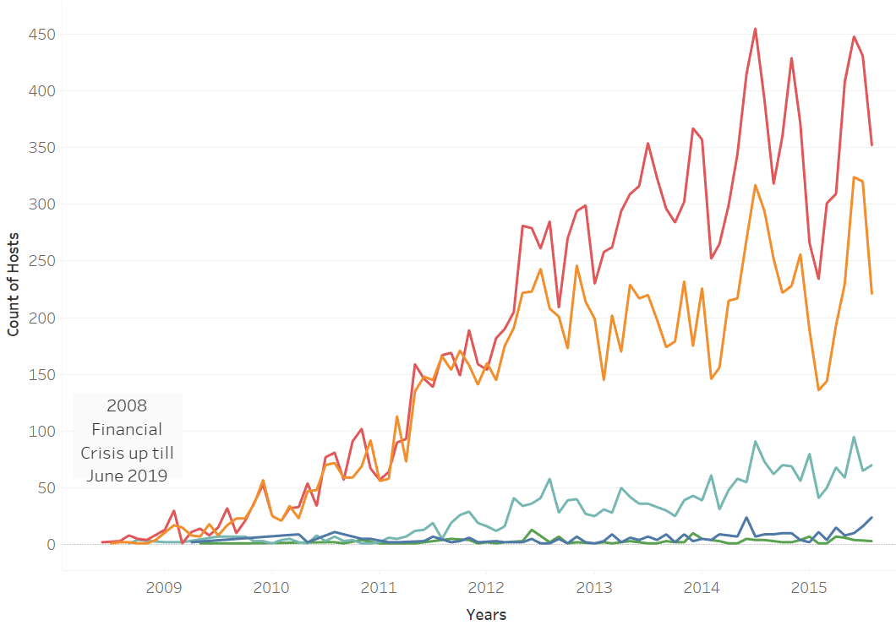
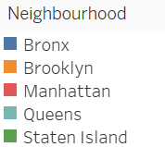
Geographical registration rate – Yearly and Monthly
Manhattan and Brooklyn are witnessing a much faster growth in terms of host registration from 2011 onwards. We can also see seasonality in terms of host registration trend. There is a significant spike in registration on platform during the summers.
Financial Crisis Source - https://www.forbes.com/sites/qai/2022/10/19/how-long-did-the-great-recession-last-in-2008/?sh=3b2dc9bc56b0

Slide 6
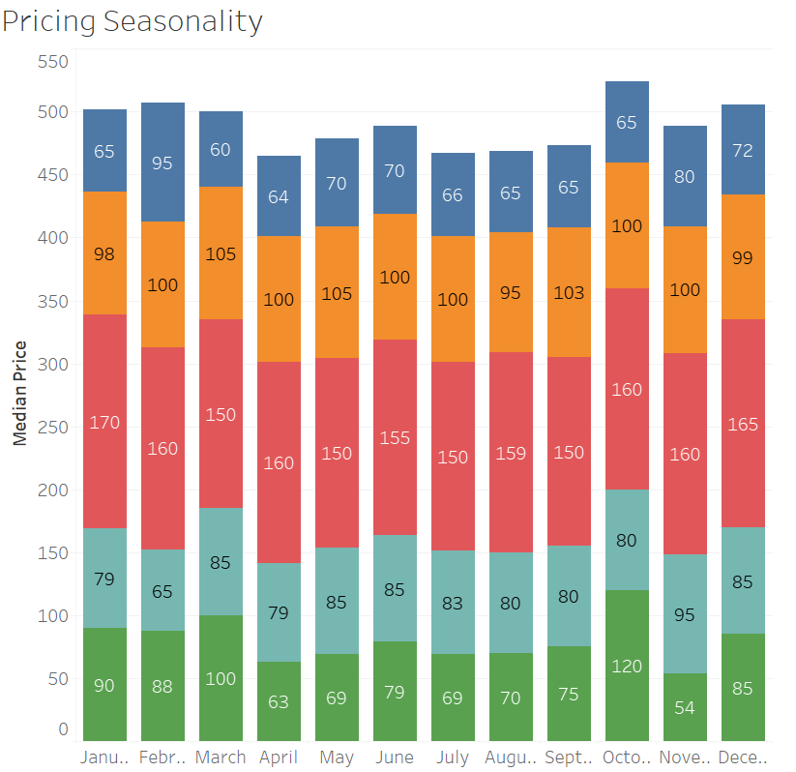
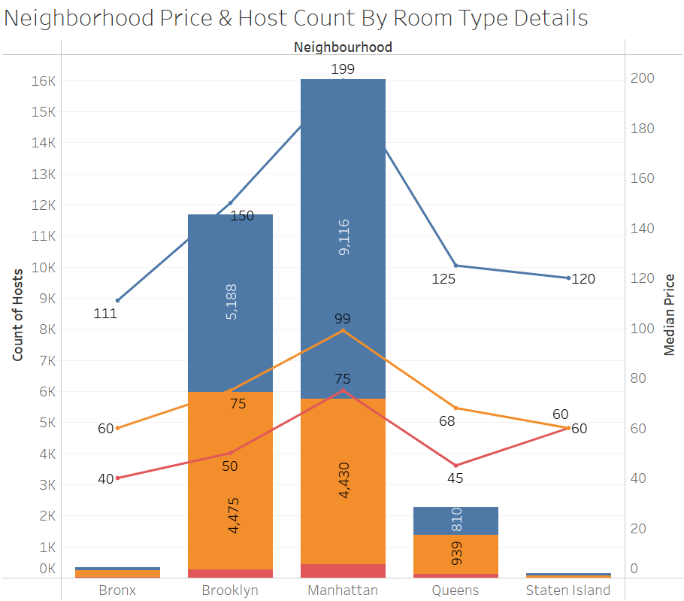
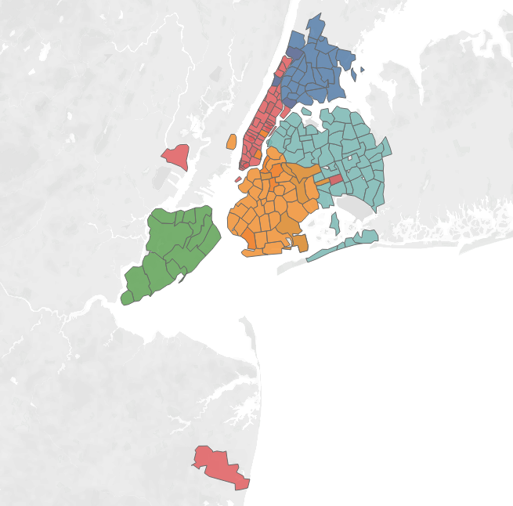
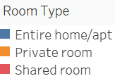
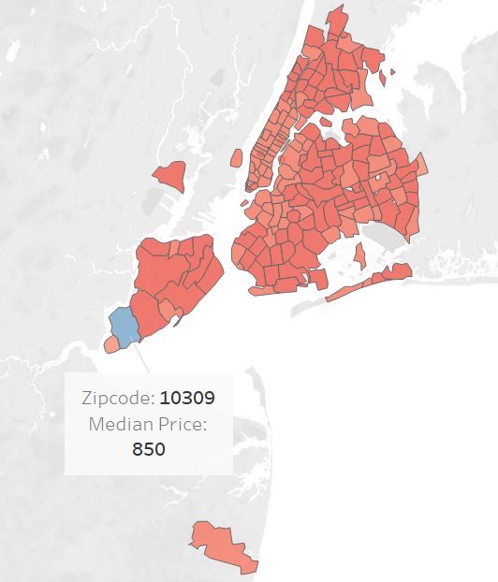
Geographical product and Pricing preference
More than 80% of listings across geographies are for Entire Home and Private Rooms
Owing to the area of the listing being higher the pricing for apartments is 2x times that for private rooms and shared rooms
Pricing does not have a lot of variance across months each year
Anomalies are present in data – prices in Staten Island (Zipcode – 10309) is much higher compared to overall distribution

Slide 7
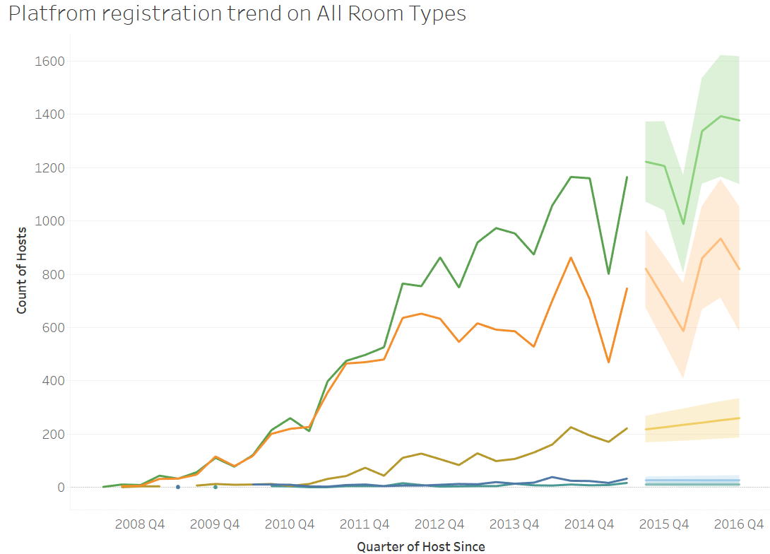
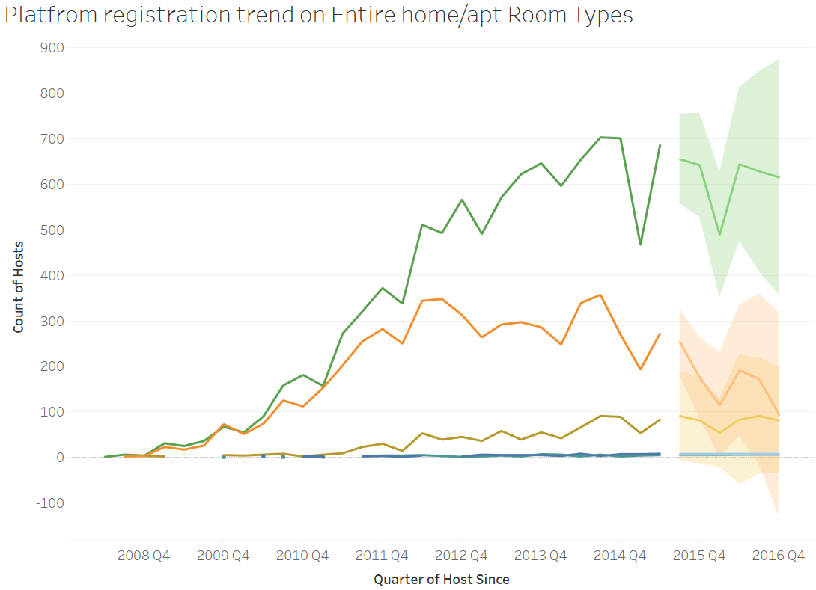
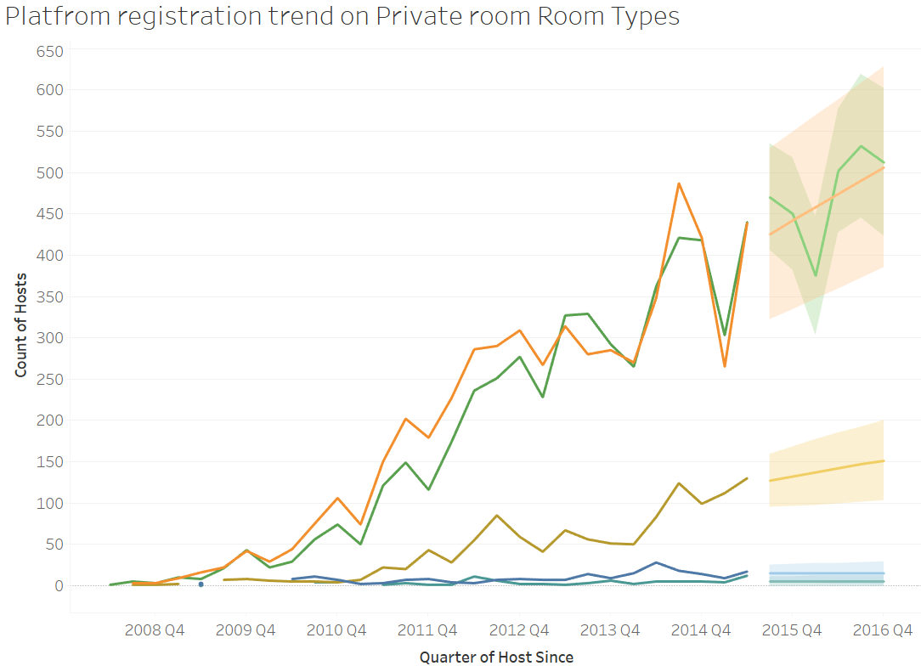
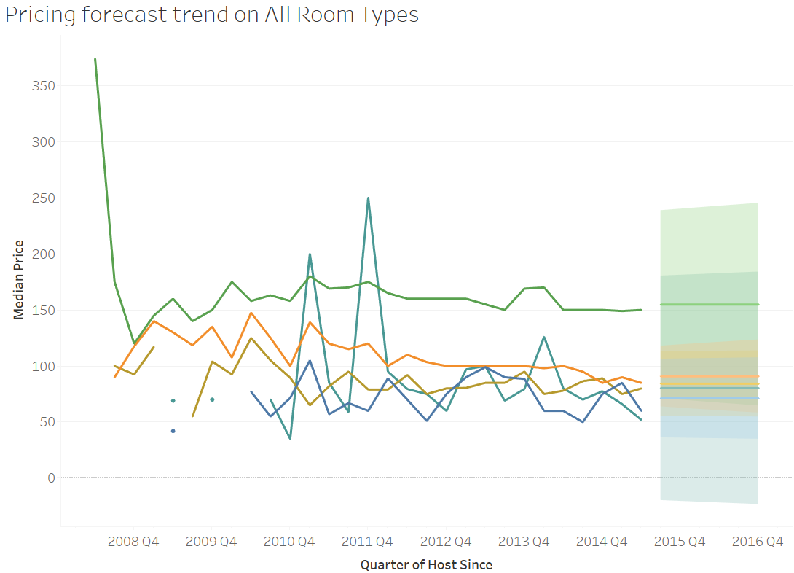
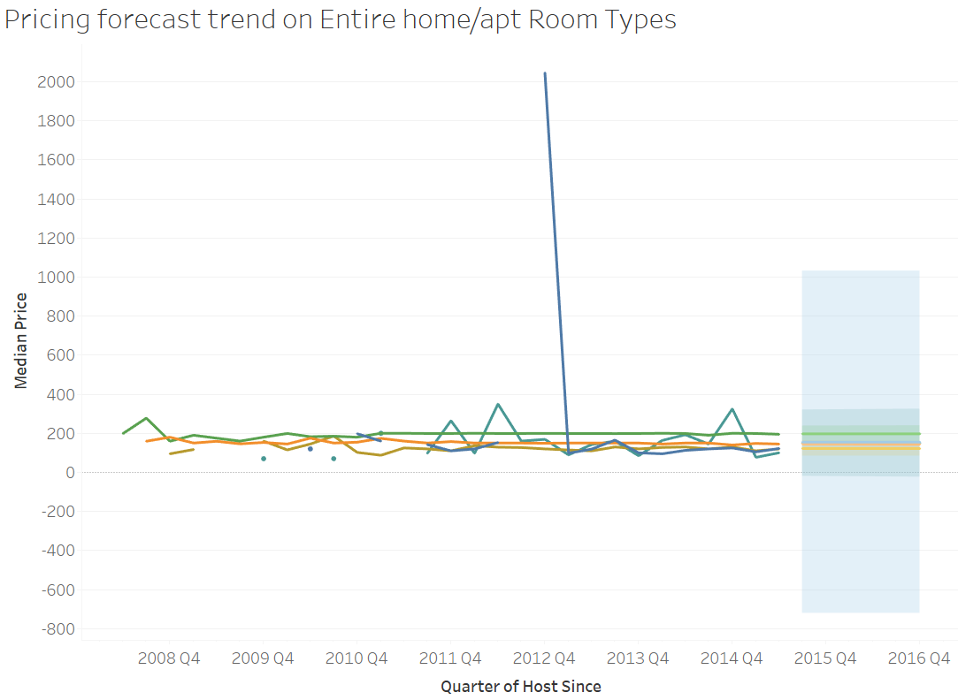
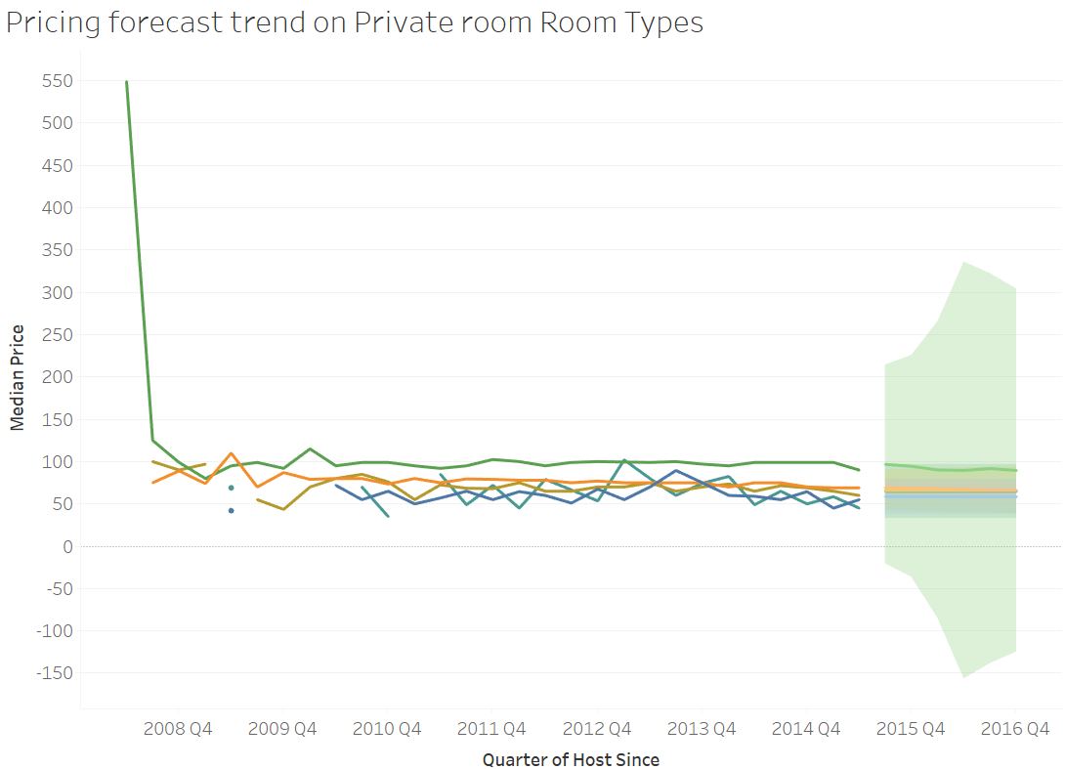
Geographical Registration and pricing Forecast
Platform Registration Forecast could not be generated on shared room type as sufficient data was not available.
Registration trend shall be going up in subsequent quarters but only for shared and private rooms. Dip in registration is anticipated for apartments.
Pricing will stay as it is without much variance anticipated in the median pricing.

Slide 8
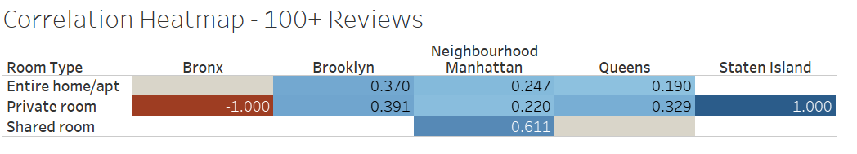
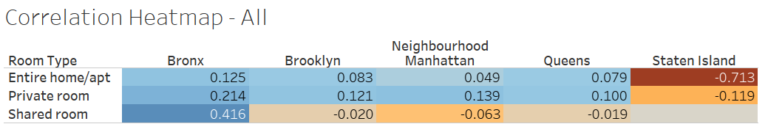
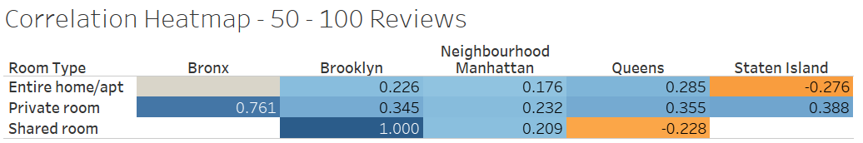
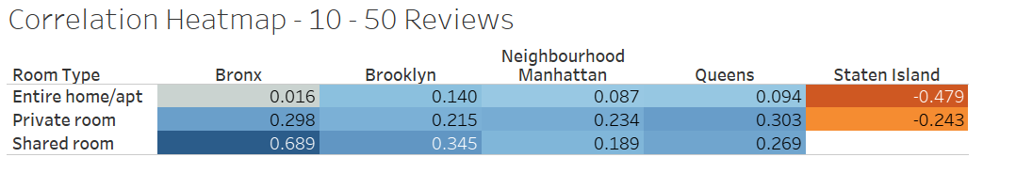
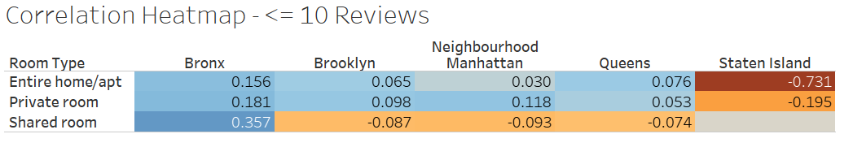
Host Rating Analysis – Correlation between pricing and rating
Geographically, customers in Staten Island are extremely price sensitive and it seems to have some negative impact on the BnB ratings.
Customer profile wise, private room and shared room customers are more price sensitive compared to users booking apartments.
From a vintage standpoint, post garnering more than 50 reviews price doesn’t seem to impact the rating much.

Slide 9
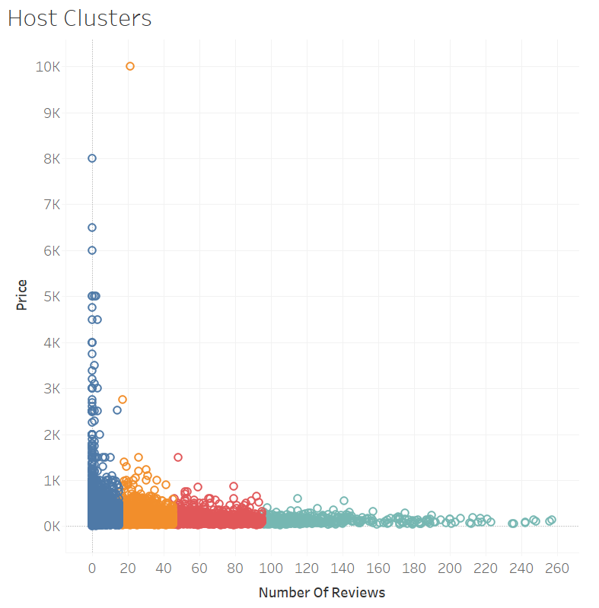
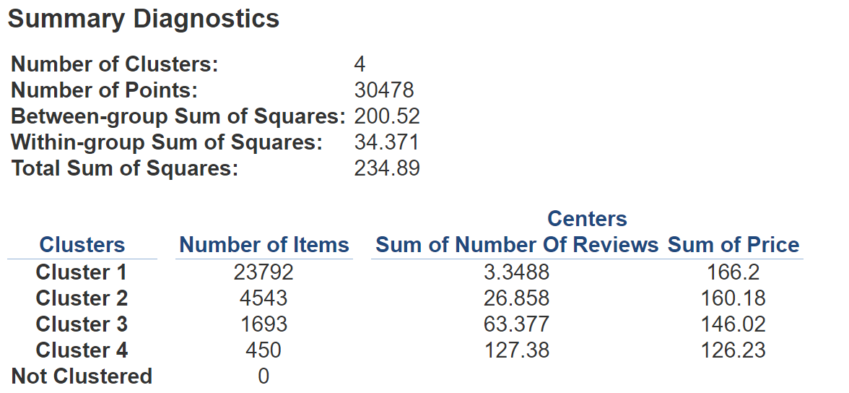
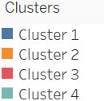
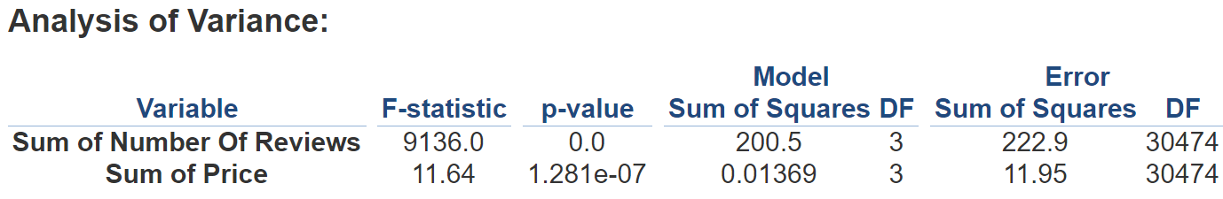
Host Rating Analysis – Most Profitable cluster of hosts
Using K-means clustering on review count and price we were able to create 4 clusters of hosts. As we can see that hosts in cluster 2 are most profitable as they have a higher review count and median price of 160. 2nd most profitable cluster of hosts is cluster 3, they have higher review count, but their median price is slightly lower than that of cluster 2.
The reason we claim that these customers are profitable is because of higher pricing (which means more commission for Airbnb) and higher review count (higher popularity, which will lead to higher bookings in future)

Slide 10
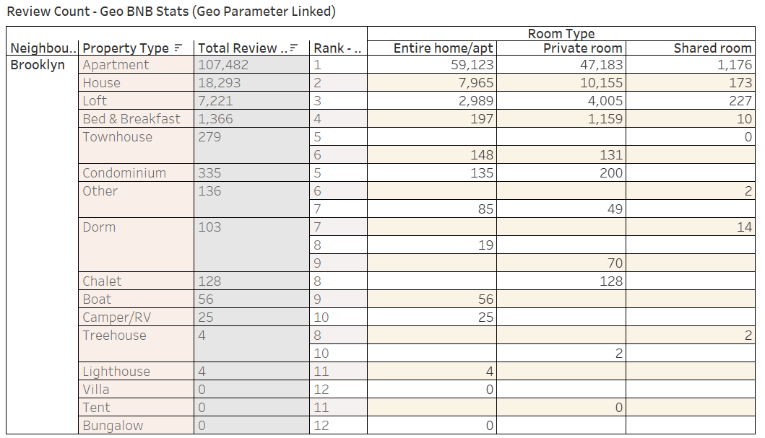
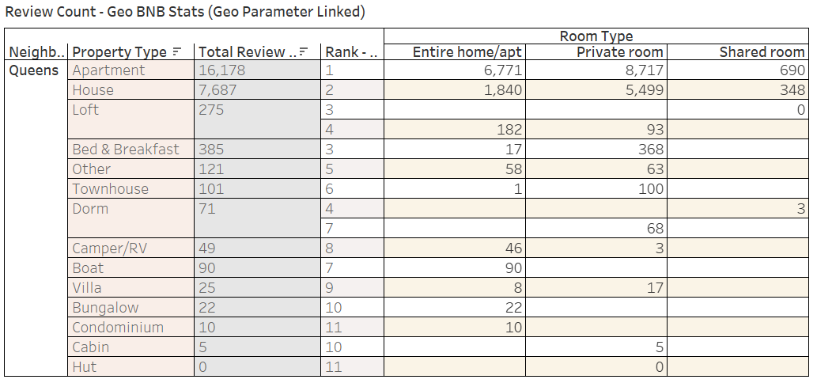
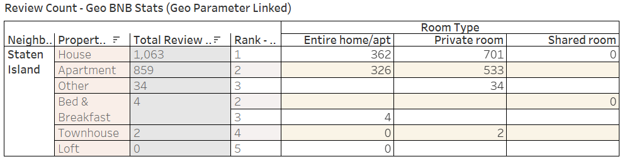
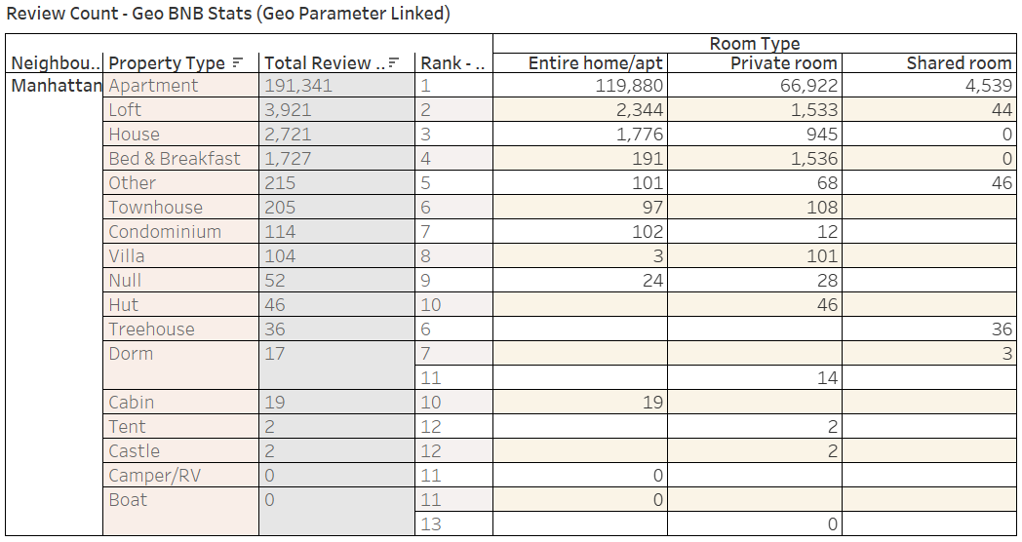
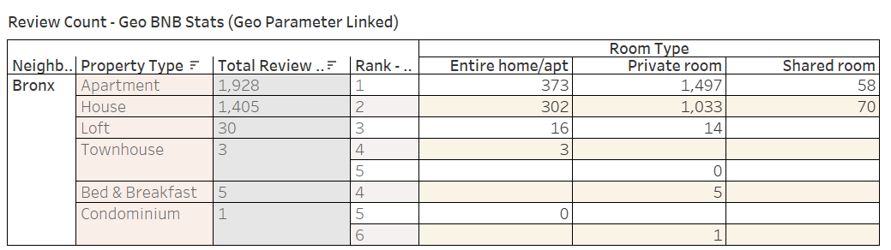
Preferred Property Type Across Geographies
Across all the geographies we can see that the predominant listings are those of apartments and homes and the preference is majorly for complete houses and private rooms.

Slide 11
THANK YOU

